Slide 1

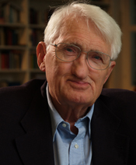
Lecture Two: Habermas

Slide 2
Background to Habermas: Adorno and Horkheimer’s critique of the instrumental rationality
Adorno and Horkheimer argued that the legacy of modernity is fundamentally ambiguous: while it claimed on the one hand to free the individual from external political and religious oppression (through rationality) it also produced a kind of instrumental reason which led to modern forms of totalitarianism and barbarism, in particular Nazism and the Holocaust.
In capitalism, people are objectified in the same way – but as consumers; they are subjected to the profit motive, to advertising, to marketing strategies and to the expectation to mindlessly consume. In this way we are alienated.
Instrumental rationality becomes a way of dominating the world. It has become entrenched in modern societies, and has lead to people being treated simply as objects (of extermination, or scientific enquiry)
What is lost in this process is any kind of escape from rationality – there is no more place for myth, art, etc.

Slide 3
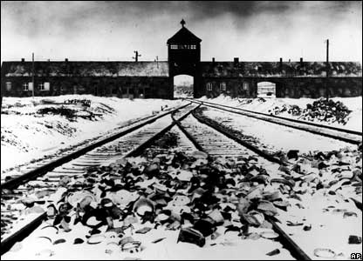
Instrumental rationality: the Holocaust

Slide 4
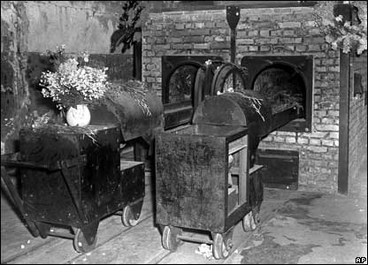
Instrumental rationality: the Holocaust

Slide 5
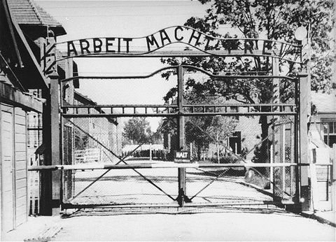
Instrumental rationality: the Holocaust

Slide 6
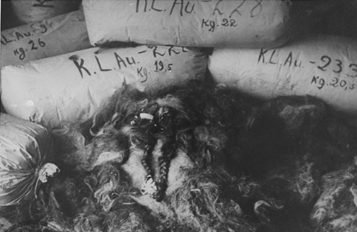
Instrumental rationality: the Holocaust

Slide 7

Capitalism: the culture of commodification

Slide 8
Habermas’ defence of modernity
Habermas wants to defend the project of modernity – while he recognises that is has gone awry, and while he recognises the dangerous implications of instrumental reason highlighted by A and H, he argues that there is another side to the discourse of modernity – one that offers us the possibility of freedom and autonomy.
He rejects the idea that the process of rationalization necessarily leads to a process of domination – there are other ways of using and harnessing the rational legacy of the Enlightenment.
The problem with A and H’s argument is that it denies us any sort of normative position from which to criticise existing society. They leave us trapped in the society they condemn.
We have to distinguish between the rational and irrational aspects of the Enlightenment – and salvage the former so that we can criticise the later.
We as human beings have interests that are largely rational - and most claims about knowledge are intrinsically linked to a human interest in emancipation. In other words, all forms of rational thought and inquiry have their basis in some notion of human interest, and some idea of human emancipation – so scientific inquiry is really about liberating us from ignorance, allowing us to determine the conditions of our existence, free us from forces that we cannot control.

Slide 9
Theory of Communicative Action (1970s)
The process of rationalization has allowed us, as members of a linguistic community (community of speaking beings) to make certain truth claims about the world as well as to make moral claims about shared norms and values.
We are able to make distinctions between a number of different spheres of experience:
  1) cognitive-instrumental - the objective world of facts to which we refer when we make truth claims
  2) normative - our shared social world of recognised norms to which we appeal when we make moral claims
  3) subjective-aesthetic - the subjective world of individual private experiences which person expresses when he makes aesthetic or expressive claims
Each of these corresponds to a certain speech act:
  1) assertions that purport to be true
  2) promises or commands that claim to be normatively binding
  3) avowals that purport to be sincere from a first-person perspective
These three spheres or domains and their corresponding speech acts all depend on a lifeworld: a background of practices and assumptions that inform a shared orientation to each of these three worlds; it forms the context for intersubjective communication and action
The rationality that is proper to this lifeworld is what Habermas calls communicative rationality: the shared capacity of all members of a speaking community to reach a consensus through reasonable argument and discussion.
The regulative ideal for this process of communication – in other words, the ideal that this form of rational communication works towards – is the ideal speech situation: an ideal of unconstrained, undistorted rational inquiry in which all members of the community collectively seek agreement without any threat or fear of coercion.

Slide 10
Discourse ethics
The conditions that speech acts have to fulfil for the process of rational communication to work:
The speaker:
  1) has to be comprehensible: has to speak in a way that he can be understood by the other
  2) has to have the intention of speaking the truth
  3) has to be sincere: has to believe in the truth of what he says
  4) has to speak in a way that is appropriate to existing norms and values of the hearers, so that the utterance can be accepted by the others and that some form of agreement can be reached
The listener can:
  1) challenge the utterance as unintelligible
  2) challenge the utterance as false – based on a falsehood
  3) challenge the utterance as insincere
  4) challenge the utterance as inappropriate.

Slide 11
Political applications
Deliberative democracy – discourse ethics can outline the rules of democratic decision making
Seyla Benhabib argues that any notion of democratic legitimacy must ultimately be based on an unconstrained communication on matters of common concern. This deliberative understanding of democracy is based on an agreement about the discursive rules and procedures for communication, such as norms of equality and symmetry, the right to question assigned topics of conversation and the right to initiate arguments about these very rules themselves.
Constitutional patriotism – the politics of the ‘post-national condition’
Globalisation is leading to the erosion of the significance of the nation state in international system and the possibility of a new global civil society (influenced by Kant’s idea of a cosmopolitan order of international laws and peace between nations). The political value that is appropriate to this post-national age is what he calls ‘constitutional patriotism’: a form of citizenship which is based on a shared sense of values and principles (agreements about certain fundamental rights) rather ethnicity or shared history.

Slide 12
Criticism of rational communication
Habermas has argued that this model of discourse ethics is universal – in other words, that this points to a kind of universal tendency towards rational communication that is somehow inherent in the human species, regardless of cultural difference.
  But how can we be sure that members of other cultures always implicitly raise the same validity claims?
  How do we have an ideal speech situation with someone from a completely different culture, or someone who refuses to accept the rules of discourse ethics?
J-F Lyotard (Postmodern Condition) rejects notion of universal rational communication. All we have in society are heterogeneous speaking positions (language games) which are incommensurable with one another and which do not seek consensus.
  The desire for consensus is terroristic, because it only operates through a violent exclusion of certain perspectives which don’t fit into it.
J. Lacan: clear, undistorted communication is a structural impossibility – not because we do not have the capacity to be sincere, truthful etc, but because of a structural limitation in language itself. There This is an internal limit (the Real – that which cannot be represented) in language itself, which disrupts and distorts the process of clear communication. Try as we might, we can never entirely say exactly what we want to say or in the way we want to say it, not because we are inarticulate or lack the capacities of clear communication, but because of a flaw or void within the structure of communication itself. Thus, while Habermas recognises that there might be external barriers to communication – like money, power relations – he neglects the way in which barriers might also be internal to communication.

Slide 13
Defending Habermas
Despite its limitations and problems, his theory of discourse ethics and communicative action at least provides us with the most viable model of deliberation. In other words, if we are to have some form of collective decision making in society, would we not prefer that it works on the principles of discourse ethics and communicative rationality rather than on power relations and coercion? A process of decision making based on people having a free and equal access to deliberation, where people speak truthfully and sincerely, where people are free to question and debate what has been said, where everyone is given an equal hearing, and where the decision that is made is only provisional – would seem to present the only normatively desirable way of arriving at decisions collectively.
  Surely this would be better that what ‘democratic’ government do today – claim to have a democratic mandate while often acting unilaterally in their own interest.
Habermas would say that the fact that at all levels we take part in collective deliberation and decision-making (even if just at a community level) shows that we have at least the potential to communicate according to certain rational and moral norms.

